Slide 1

Milestone 2 : Creation of the app storing system and fully functioned Main page
Team members:
Badr Elsayed - 22010664
Adham Anas- 22010601
Mohamed Mostafa Sayed - 22011170
Nour Khaled Mohamed - 22011319
Ali El-Deen Maher - 22010934
Yousef Awad – 22011390

Slide 2
GOAL OF THE MILESTONE
Creation of the app storing system and fully functioned main page (Task Tab)

Slide 3
List of accomplished tasks:
Creation of the app storing system and fully functioned main page (Task Tab)
Created the “Add’ function : Create a new task with specific parameters which are: task title , task description , priority (low, moderate, high) , tags, Due date, repeating manner.
Manipulation of a current task : Edit : edit any parameter of the task previous mentioned parameters. Delete : delete any task. Completed/Incompleted : Change the state of task from completed to incompleted and vice versa Add Steps : Add sub-tasks to current task
Created the “Search” function : Search for a specific task(s) based on the entered text in the search bar which search through the task fields for the entered key word.
Created the “Sort” function :Sort Current tasks based on 3 criteria (title, priority, due date) in both ascending and descending order
Created the Storing systems : Saving the current tasks fields in Json files.
More in depth in the upcoming screenshots of the app.

Slide 4
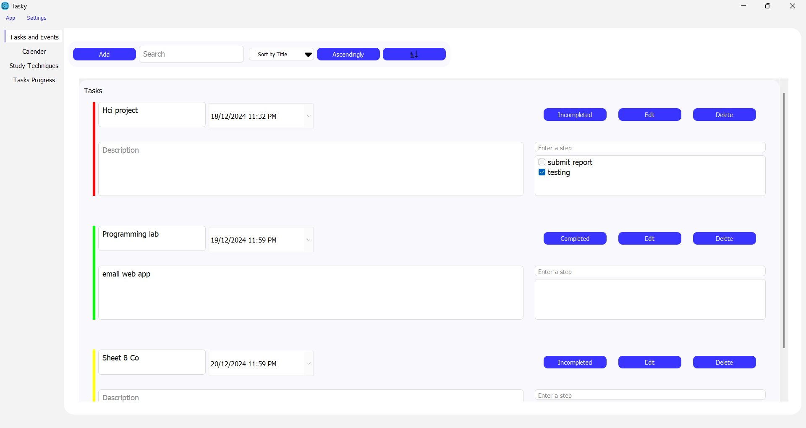
Overview of the Task Tab :

Slide 5
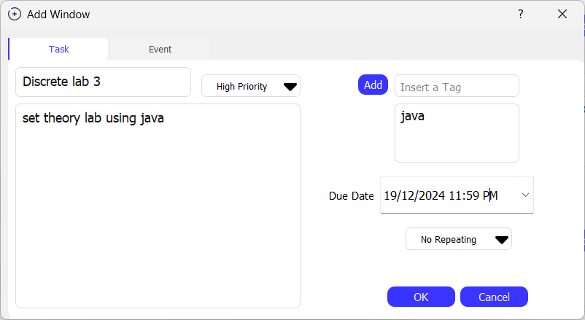
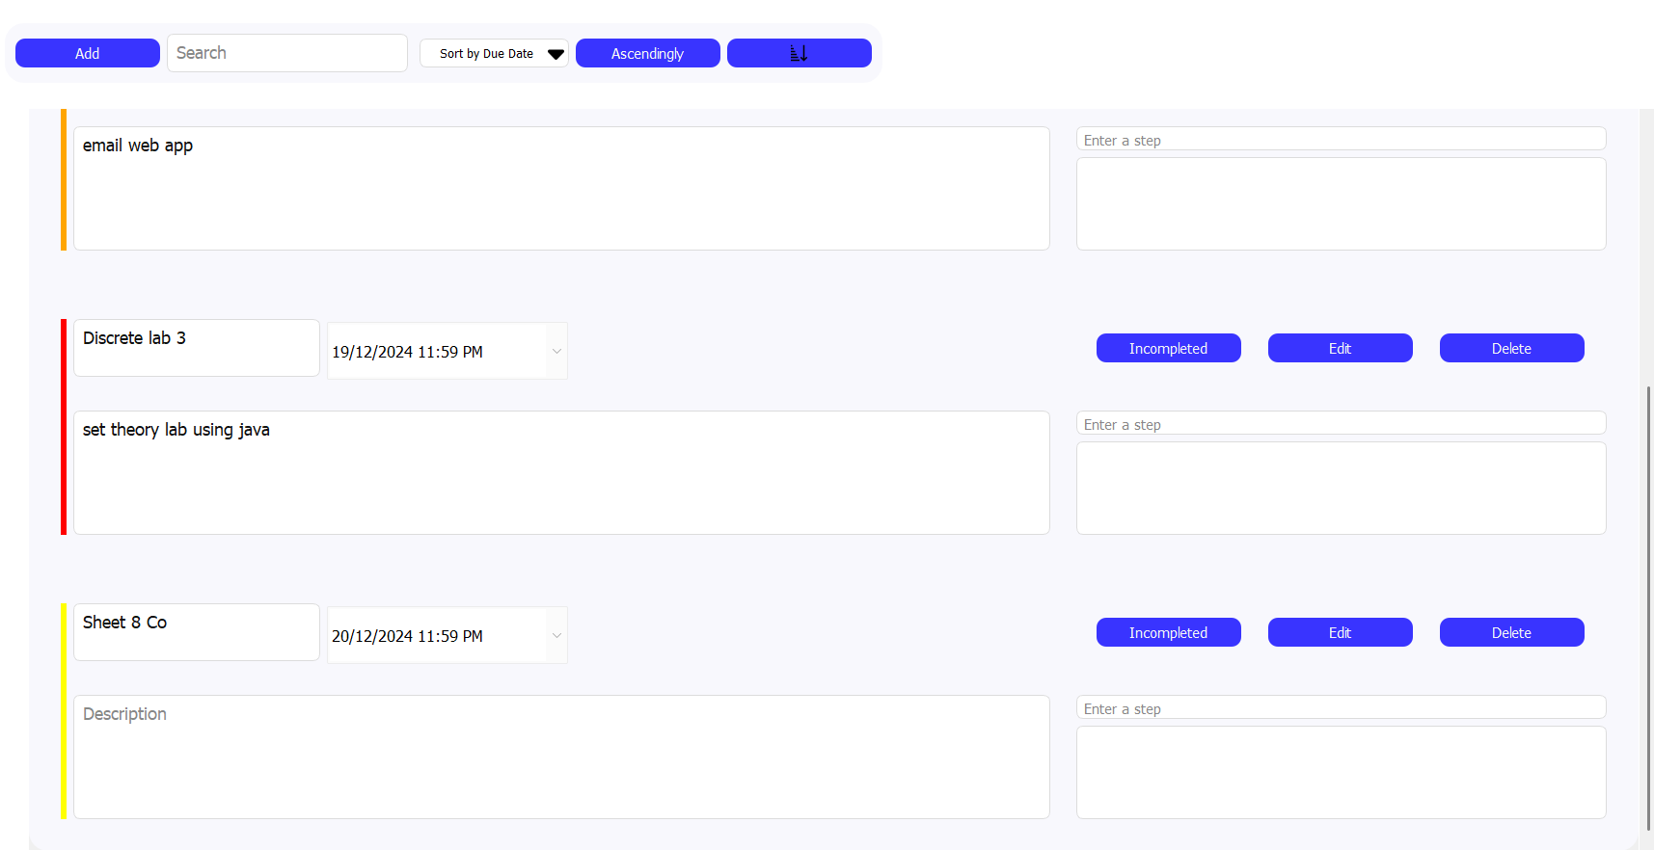
Creating a new Task:

Slide 6
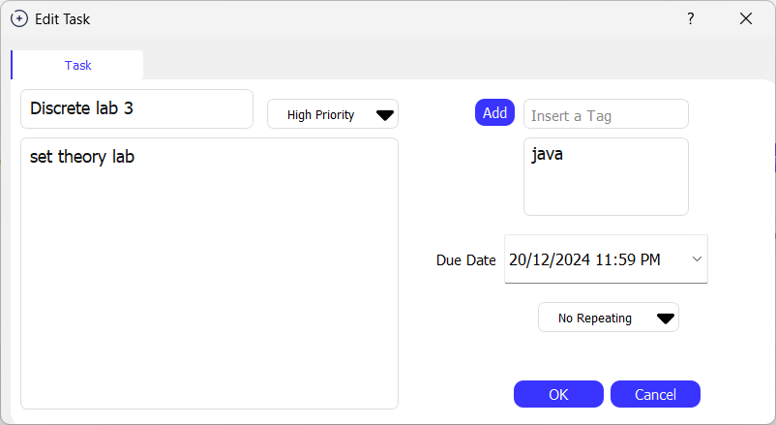
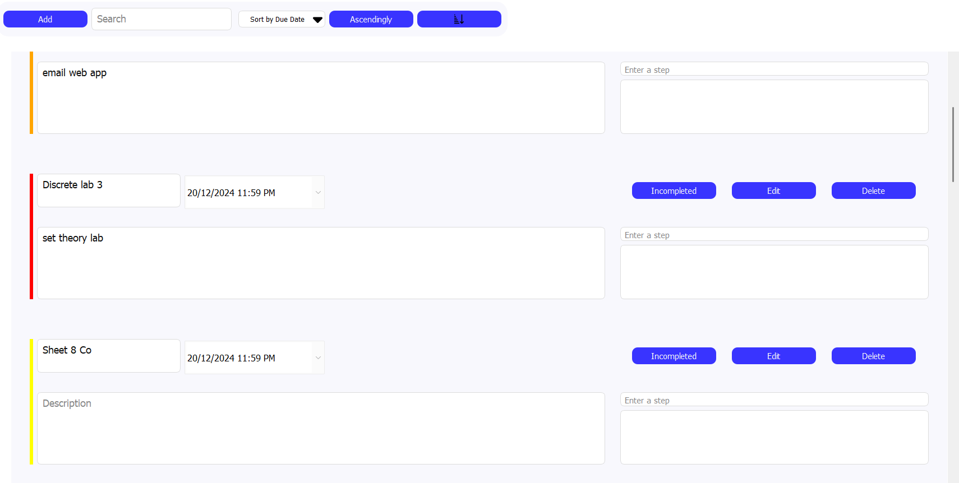
Editing an existing task :

Slide 7
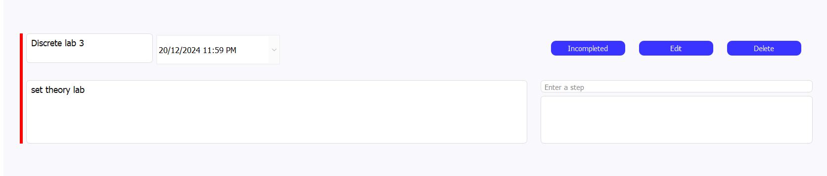
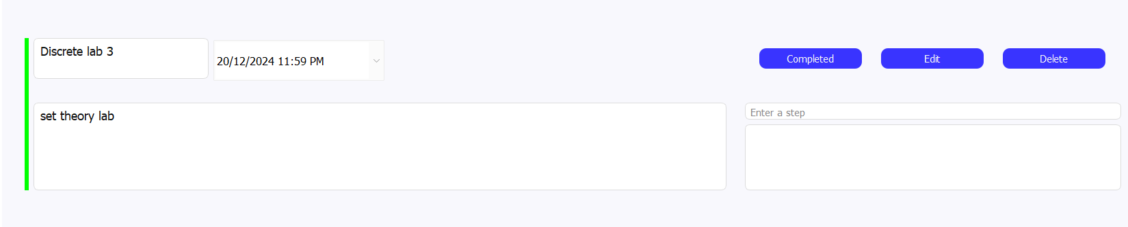
Set a task as Completed:

Slide 8
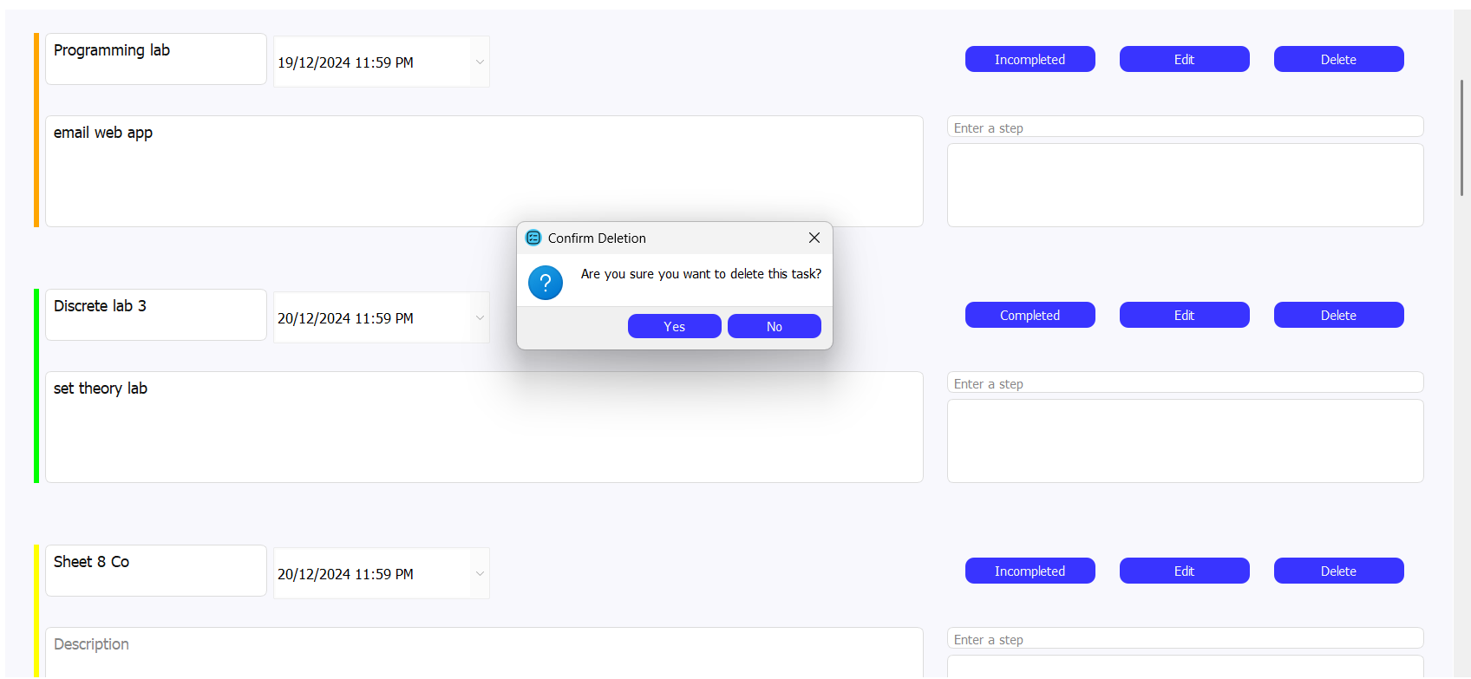
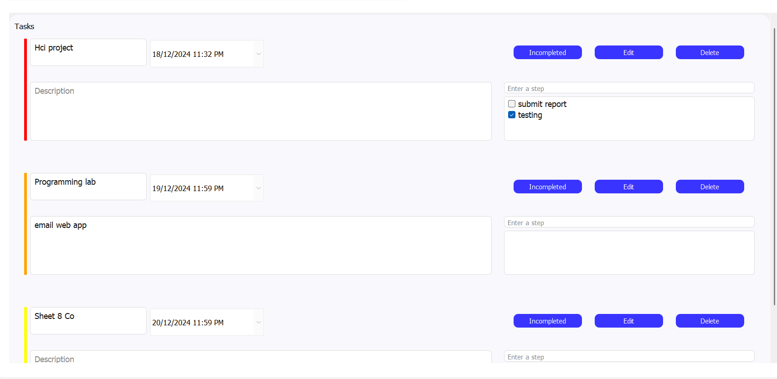
Delete an existing task:

Slide 9
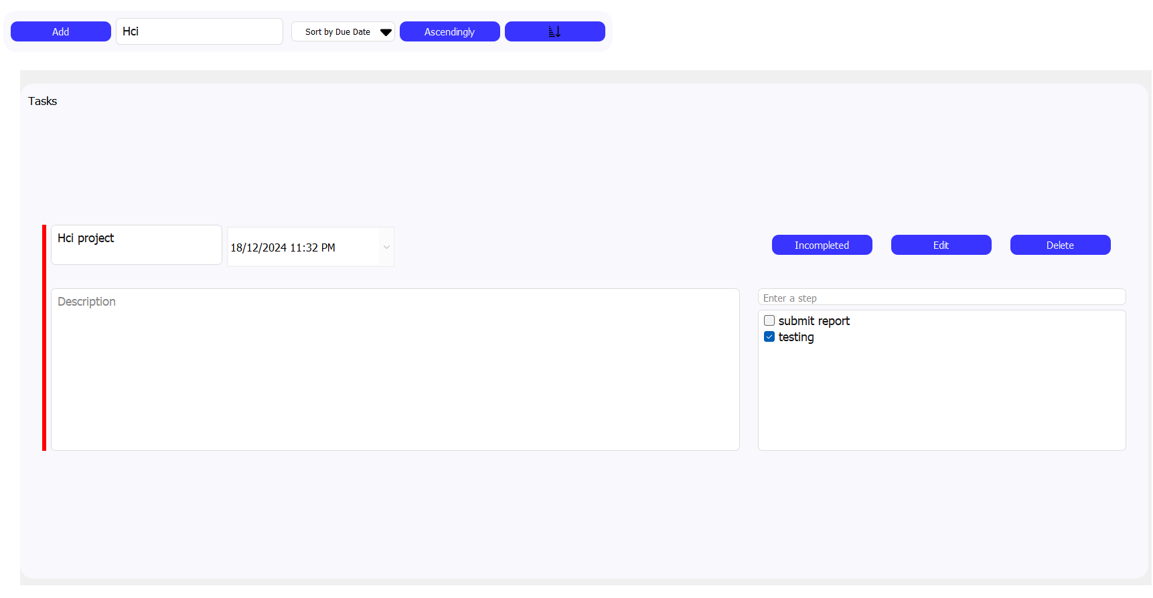
Search for a task: a) By Title

Slide 10
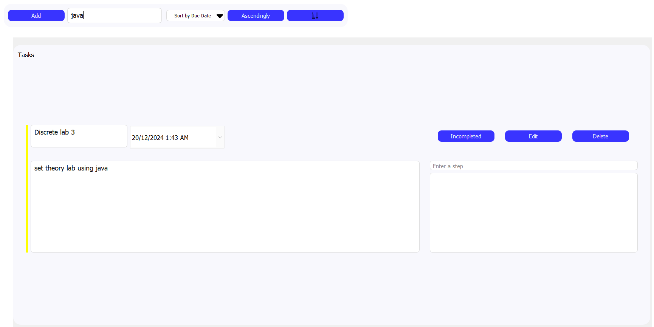
Search for a task: b) By Tag

Slide 11
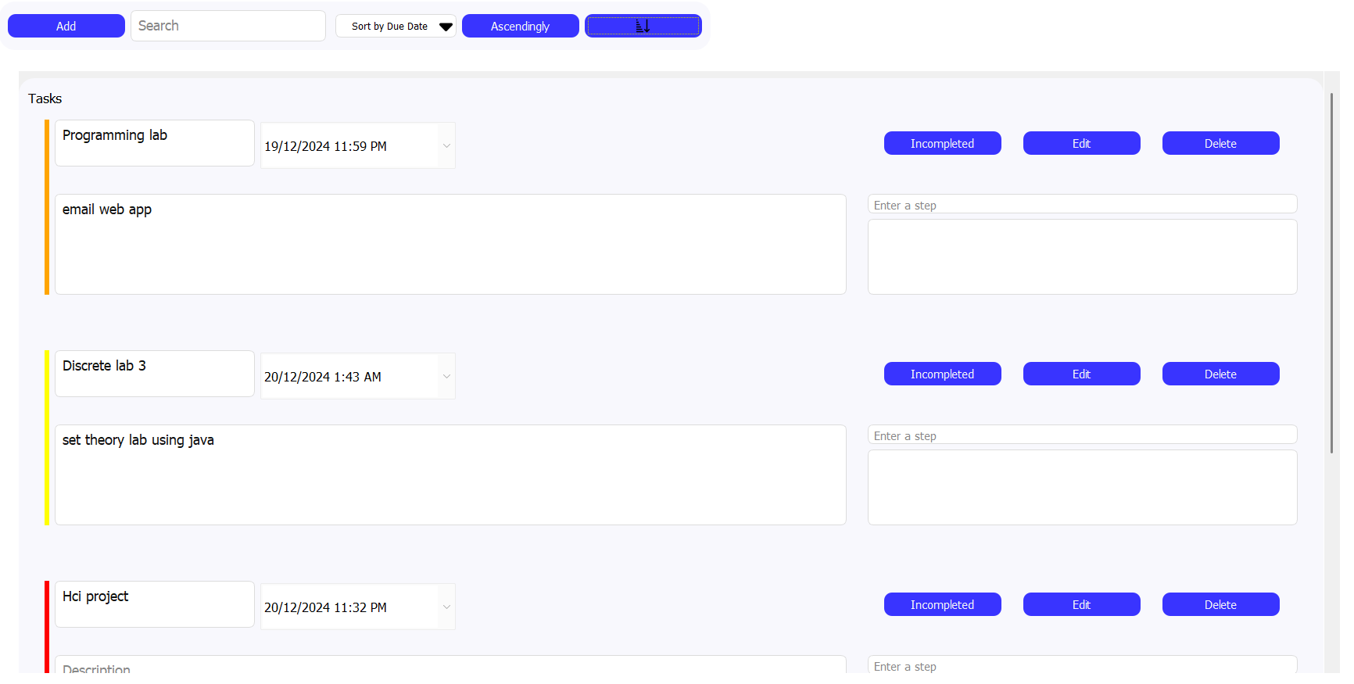
Sort Existing tasks: a) by Due dates

Slide 12
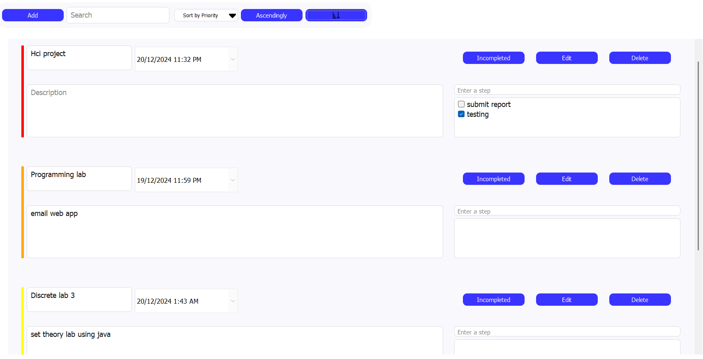
Sort Existing tasks: b) by Priority

Slide 13
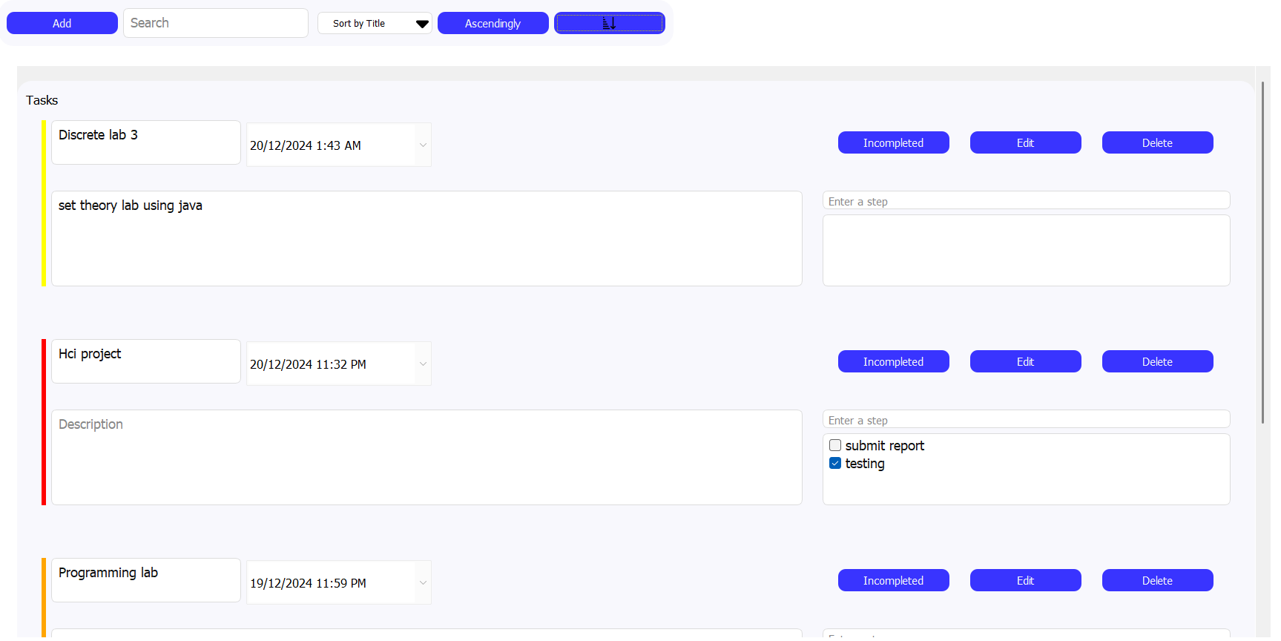
Sort Existing tasks: c) by task title

Slide 14
External links to code:
Currently our Github repo is private until we finish, so I’m providing a mediafire link of the code.
Link:
https://www.mediafire.com/file/47ek8r3i2769dtv/2nd_Milestone_App_Upload.zip/file
Steps to run app:
1- Install the following python library by running the following line in a terminal:
pip install pyqt5
pip install pyqtchart
2- Run the app by running the file “main.py” using a python interpreter.

